Slide 1
Pharmacologic Treatment of Schizophrenia
Student’s Name
Institution of Affiliation
Course Code and Name
Professor
Date

Slide 2
Primary Question
Objective:
To review and highlight recent developments and current controversies in the pharmacological treatment of schizophrenia.
To highlight areas where there gaps in the knowledge exist with regards to this
Primary Question:
What are the recent developments in the pharmacologic treatment of schizophrenia?
What are the current controversies surrounding the pharmacologic treatment of schizophrenia?

Slide 3
Innovation of Research Question
Based on the researcher’s interest and approach to the topic
Followed the need to identify information gaps regarding the topic so as to guide future research recommendations
Achieve this best by way of:
Depicting recent trends and hence developments on the topic
Depicting current controversies in the topic which are the smoking guns to help deduce topic and recommendations for future research

Slide 4
Application of Innovation
Helps to identify the information gaps in the body of knowledge with regards to this topic that could be exploited in informing directionality of future research and hence providing comprehensive knowledge basis that would help to significantly improve the pharmacologic management of the disease

Slide 5
Relevance of Innovation
It will help provide vital information that would in providing comprehensive knowledge basis that can direct effective pharmacologic management of the disease

Slide 6
Significance of Primary Question
It helped to highlight the areas that need improvement where the treatment of the disease is concerned.
It helped to highlight the recent development in the pharmacologic management of the disease.
It helped to highlight the current controversies that are associated with this type of treatment
It helped to highlight new areas that would require further research
It helped to bring all the information regarding the pharmacologic treatment of schizophrenia in one place

Slide 7
Societal Impact of Primary Question
It helped the society to appreciate further the manner in which the pharmacologic treatment of schizophrenia works
It helped to highlight the important position that pharmacologic treatment of this disease assumes within the life of the individual
It helped in providing more insight into the controversies of the pharmacologic treatment of the disease
Provided guiding principles that would enable the individual to be informed about their treatment options and hence monitor their treatment more effectively

Slide 8
Procedure: Methodology
Descriptive approach to the research questions
Systematic Meta-analysis of available literature
Guiding hypothesis:
By way of identifying the information gaps within the existent body of knowledge through systematic and comprehensive review, the type of research ideally suited to fil these gaps can be identified and discussed
Review of ALL available information on the topic

Slide 9
Sustainability of the Methods
Provided a bulk of information was instrumental in answering the major research questions by way of:
helping the researchers to outline the current controversies
helping in the identification of recent developments especially where the review was conducted in chronological order starting with older literature as they approached the more recently published review and primary articles

Slide 10
Limitations of the Methods
Failed to provide the inclusion criteria of how they chose the literature that they reviewed
Failed to expound more on the scheme that they applied in their review making their research impossible to replicate
Failed to provide the research recommendation of some of the research topics that they had identified

Slide 11
Hypothesis Explanation
Hypothesis:
By way of identifying the information gaps within the existent body of knowledge through systematic and comprehensive review, the type of research ideally suited to fil these gaps can be identified and discussed.
Explanation:
Theirs was guided by the need to identify gaps in the knowledge that is rooted in the topic
By identifying the gaps and the controversies, they could identify potent research question
From the research question identified, they can then deduce viable research suited to address each topic an hence fill these gaps

Slide 12
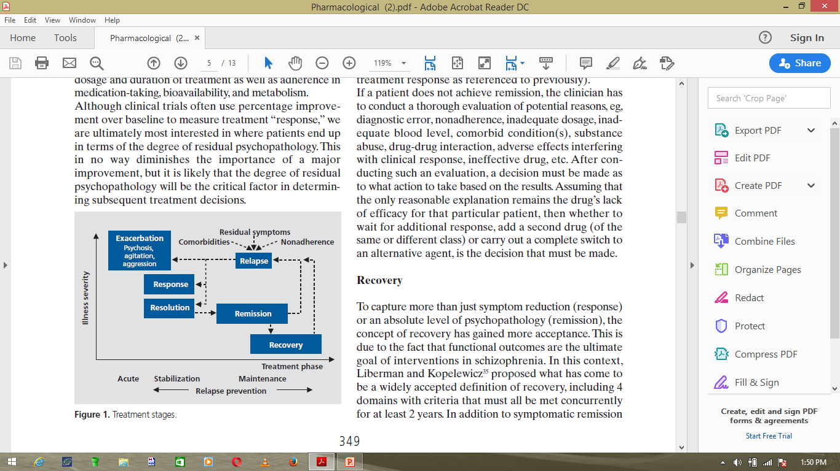
Results: Recent Developments
The researchers were able to summarize the knowledge gained in the research by way of using a flow chat to depict and summarize the treatment stages being used currently in the pharmacologic treatment of the disease.

Slide 13
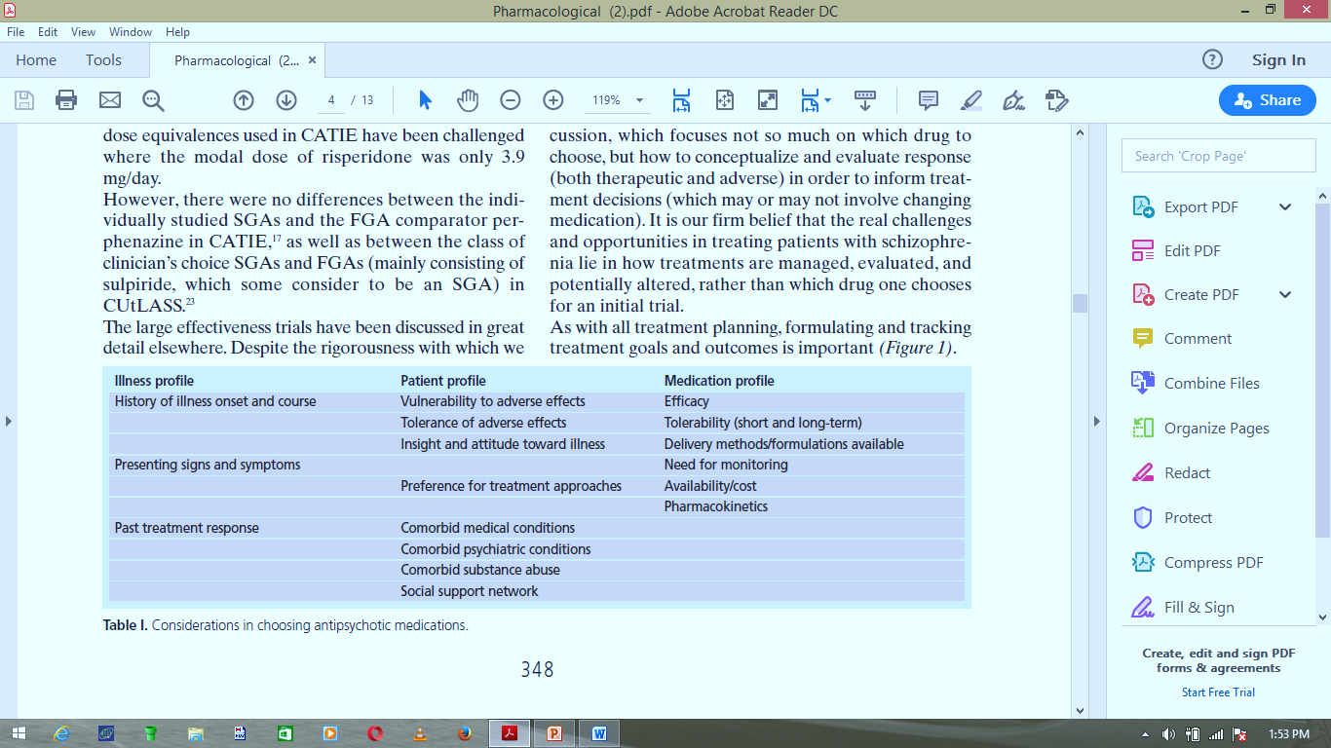
Results: Considerations in choosing antipsychotic medications

Slide 14
Results: Current Controversies
Identified the need to conduct research that would provide an appropriate validated dose equivalences of the specific medications across a range of illness phases, patient ages, and outcome domain, that is, therapeutic and adverse effects

Slide 15
Interpretation
Most antipsychotic drugs have been compared to the novel Haloperidol – the marketed leader at the point
This comparison raised logical concern That?
“the choice of that medication, and its utilization in potentially higher that necessary doses, might have served to accentuate differences in the risk for neurologic adverse effects” (Kane & Correll, 2010)
Implication:
This old comparison led to significant overdoses of the specific antipsychotic drugs with resultant increased propensity for the occurrence f drug adverse effects

Slide 16
Ethical Questions
Regarding the literature they chose to review:
Did they follow all ethical consideration of research using human subjects?
Were any subjects harmed during the research?
Did they seek approval from the relevant ethical committees and boards to conduct the research?
Was their research conducted with strict adherence to all the ethical principles of research?

Slide 17
Future Impact
Helps to highlight the areas to put into consideration by future researchers looking to replicate the research done here
Provide guidelines on how future researchers should conduct themselves in their research
Emphasizes the need to protect subjects from any and all harmful scenarios that could occur within the research settings
Continually prompts the generation of new ways to conduct research studies in an ethical manner

Slide 18
Relevance and Alternative Views
Relevance:
If science considers ethical values, then the lives of humans and other creatures are not endangered by destructive agents like atomic bombs and chemical weapons.
Measures should be taken to avoid using science against humans. This can be achieved by promotion of scientists' moral values.
Alternative Views:
Research ethics drawing from the moral principle of what is right and wrong or good or bad significantly limits the progression of research and hence development of the knowledge on human subjects

Slide 19
Conclusion
Hypothesis – Identifying knowledge gaps through comprehensive review of the available literature to help guide directionality of future research
Primary question – on recent developments and current controversies in the topic
Research – descriptive study
Method – Systematic meta-analysis of available literature
Key finding – need for provision of validated dose equivalences of the various antipsychotic drugs
Limitation – failed to identify their inclusion criteria which questions the validity of the literature use in the context of this research

Slide 20
References
Kane, M. J. & Correll, U. C. (2010). Pharmacologic Treatmnet of Schizophrenia. Pharmacological Aspects, 12(3): 345-357

